Slide 1
Autoencoder and Variational Autoencoder
Hongyu Guo
2023

Slide 2
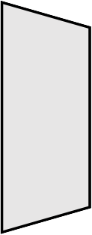
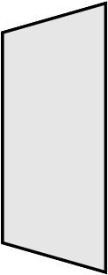


Vanilla Autoencoder
What is it?
ℒ
𝑥
𝑧
𝑥!
Reconstruct high-dimensional data using a neural network model with a narrow bottleneck layer.
The bottleneck layer captures the compressed latent coding, so the nice by-product is dimension reduction.
The low-dimensional representation can be used as the representation of the data in various applications, e.g., image retrieval, data compression …

Slide 3
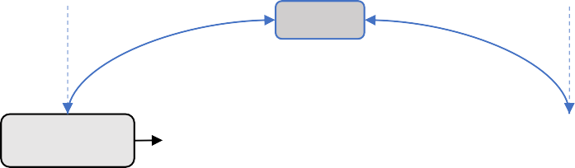
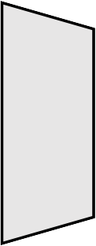
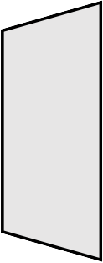

Vanilla Autoencoder
How it works?
Input
ℒ
𝑥 𝑧
Reconstructed Input
Ideally the input and reconstruction are identical
𝑥!
The encoder network is for dimension reduction, just like PCA
encoder X ➔ Z
decoder/generator Z ➔ X
Latent code: the compressed low dimensional representation of the input data

Slide 4
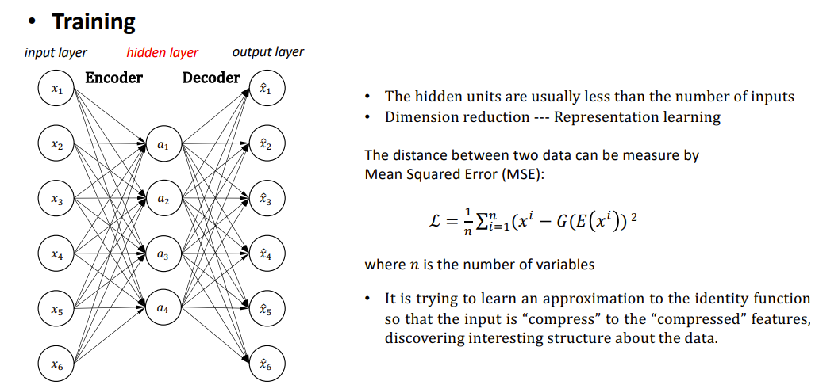
Vanilla Autoencoder

Slide 5
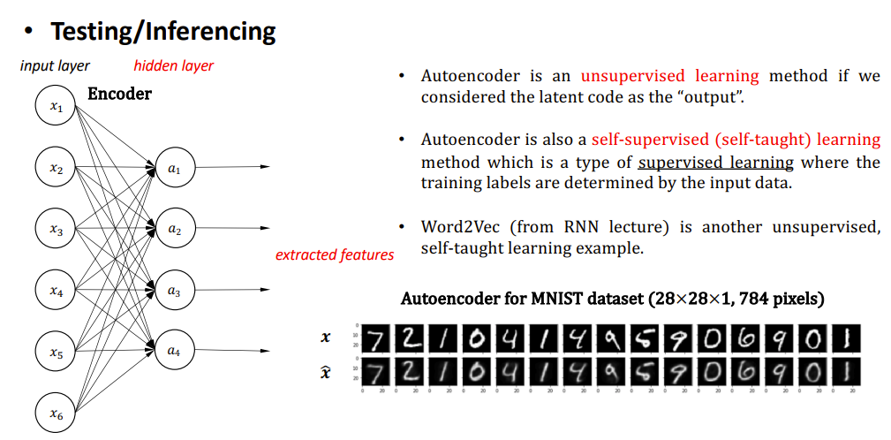
Vanilla Autoencoder

Slide 6
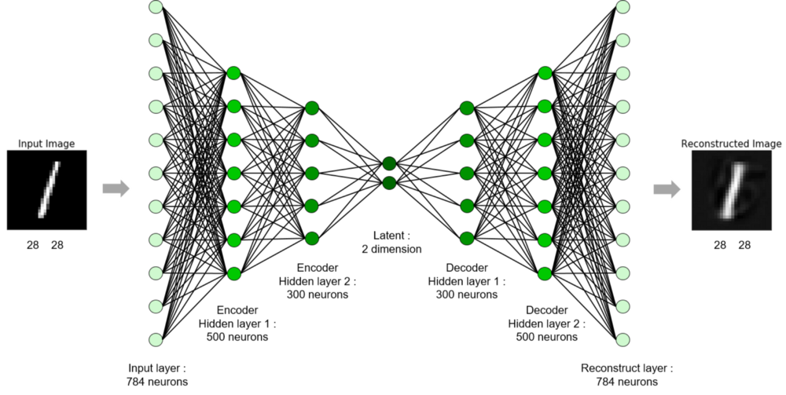
Vanilla Autoencoder
Example:
Compress MNIST (28x28x1) to the latent code with only 2 variables
Lossy

Slide 7
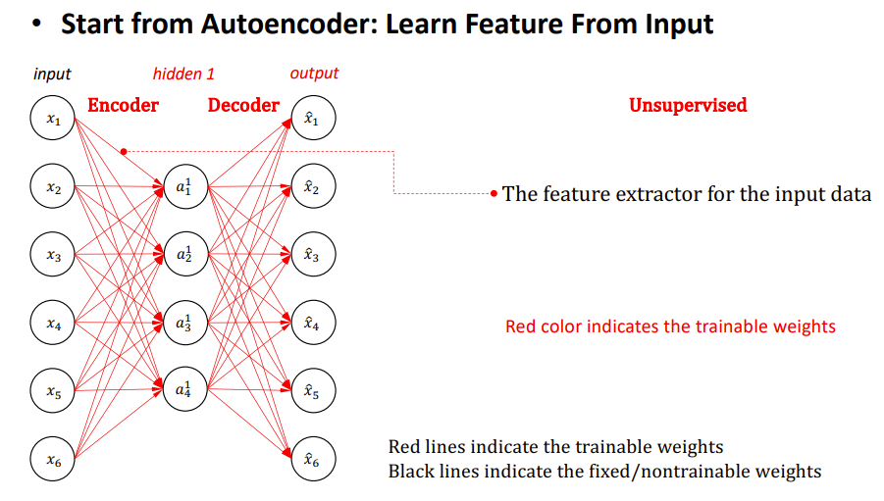
Stacked Autoencoder

Slide 8
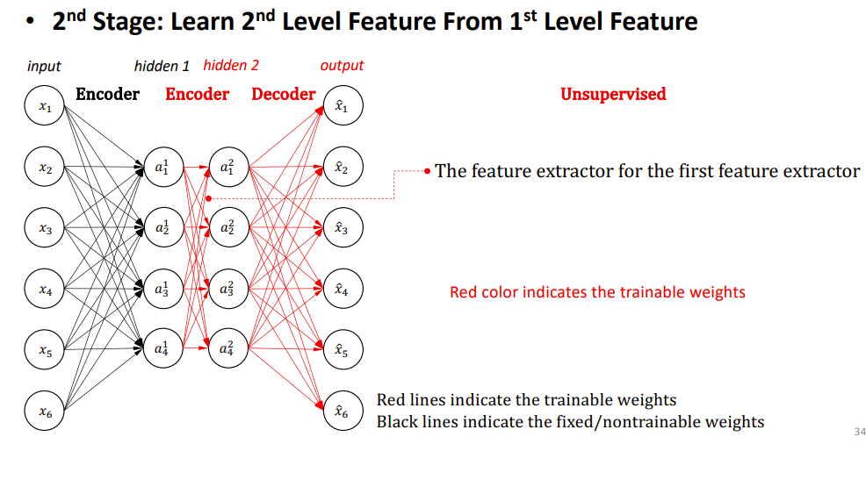
Stacked Autoencoder

Slide 9
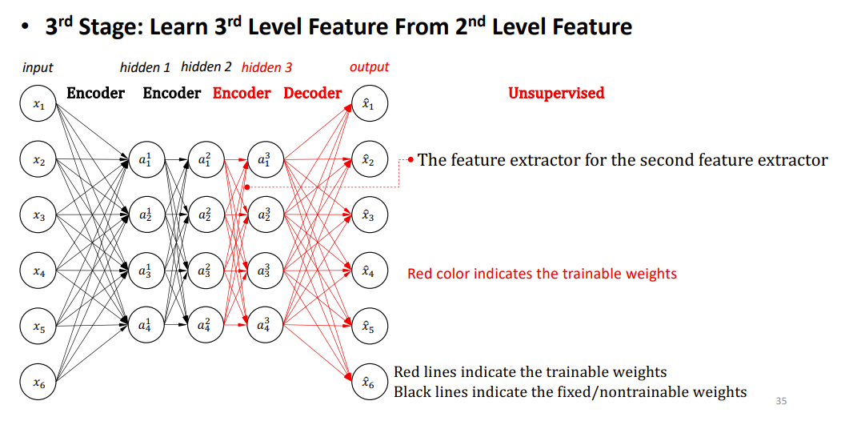
Stacked Autoencoder

Slide 10
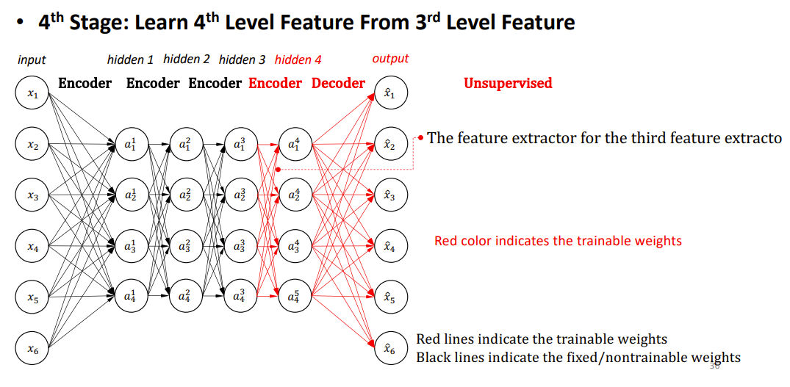
Stacked Autoencoder

Slide 11
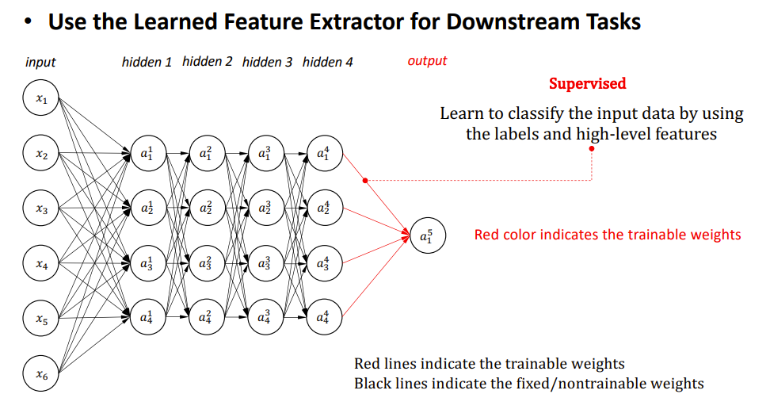
Stacked Autoencoder

Slide 12
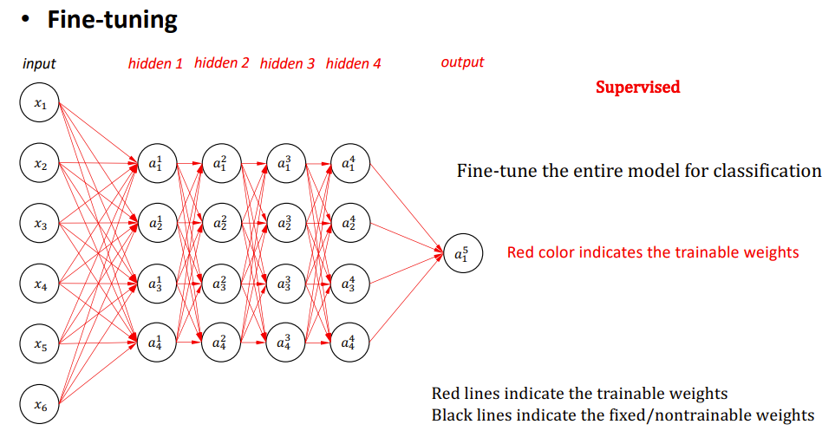
Stacked Autoencoder

Slide 13
What is an Autoencoder?
An Autoencoder is an unsupervised learning neural network. It is primarily used for learning data compression and inherently learns an identity function.
An Autoencoder network aims to learn a generalized latent representation ( encoding ) of a dataset. Autoencoder is helpful in various domains, such as for processing image, text, and audio.

Slide 14
What is generative models?
A generative model is a type of machine learning model that is trained to generate new, synthetic data that is like the training data it was trained on.
The goal of a generative model is to capture the underlying patterns and structure of the input data to produce new samples that resemble the original data distribution.
Generative models are contrasted with discriminative models, which are trained to distinguish between different classes or categories in the input data.
The primary aim of a generative model is to model the probability distribution of the input data, allowing it to generate new samples that are representative of the learned distribution.

Slide 15
Autoencoders: Generative model or Not?
Stacked autoencoders can be used as generative models, but their primary purpose is not necessarily generative.
The primary goal of autoencoders, including stacked autoencoders, is to learn a compact representation of input data in an unsupervised manner.
However, once trained, an autoencoder can be used to generate new data points by sampling from the learned latent space.
Here's how stacked autoencoders can be used as a generative model:
Latent Space Sampling: After training a stacked autoencoder, you can sample points from the learned latent space. This involves generating new representations in the reduced-dimensional space (the middle layer of the autoencoder) and then decoding these representations to produce new data points.
Data Generation: By sampling from the latent space and decoding the samples, you can generate data that is similar to the training data. The idea is that the autoencoder has learned a meaningful representation of the data, and sampling in this representation space should produce realistic samples.
Variational Autoencoder (VAE) Extension: If you specifically want a generative model, you might be interested in a variation of the autoencoder called a Variational Autoencoder (VAE). VAEs are designed explicitly for generative modeling and involve probabilistic interpretations of the latent space.
having applications as diverse as from generating fake human faces, to producing purely synthetic music.
Notes:
In summary, while stacked autoencoders are not originally designed as generative models, they can be used to generate new data points after training. If generative modeling is a primary goal, you might explore architectures like Variational Autoencoders that are explicitly designed for this purpose.

Slide 16
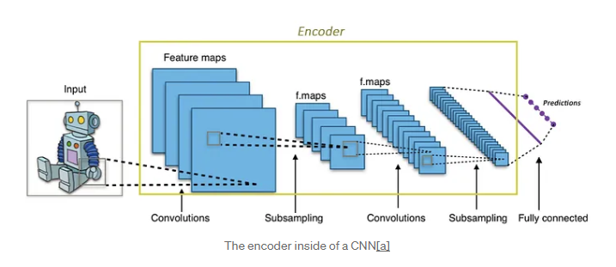
The standard autoencoder
An autoencoder network is a pair of two connected networks, an encoder and a decoder.
An encoder network takes in an input, and converts it into a smaller, dense representation, which the decoder network can use to convert it back to the original input.
Making the encoder generate encodings specifically useful for reconstructing its own input.
Notes:
The encoder is similar, it is simply is a network that takes in an input and produces a much smaller representation (the encoding), that contains enough information for the next part of the network to process it into the desired output format. Typically, the encoder is trained together with the other parts of the network, optimized via back-propagation, to produce encodings specifically useful for the task at hand.

Slide 17
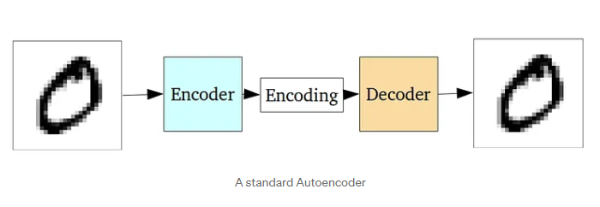
The standard autoencoder
The entire network is usually trained as a whole.
The loss function is usually either the mean-squared error or cross-entropy between the output and the input, known as the reconstruction loss, which penalizes the network for creating outputs different from the input.
Notes:
As the encoding (which is simply the output of the hidden layer in the middle) has far less units than the input, the encoder must choose to discard information. The encoder learns to preserve as much of the relevant information as possible in the limited encoding, and intelligently discard irrelevant parts. The decoder learns to take the encoding and properly reconstruct it into a full image. Together, they form an autoencoder.

Slide 18
The problem with standard autoencoders
The latent space they convert their inputs to and where their encoded vectors lie, may not be continuous, or allow easy interpolation
But when you’re building a generative model, you don’t want to prepare to replicate the same image you put in. You want to randomly sample from the latent space, or generate variations on an input image, from a continuous latent space.

Slide 19
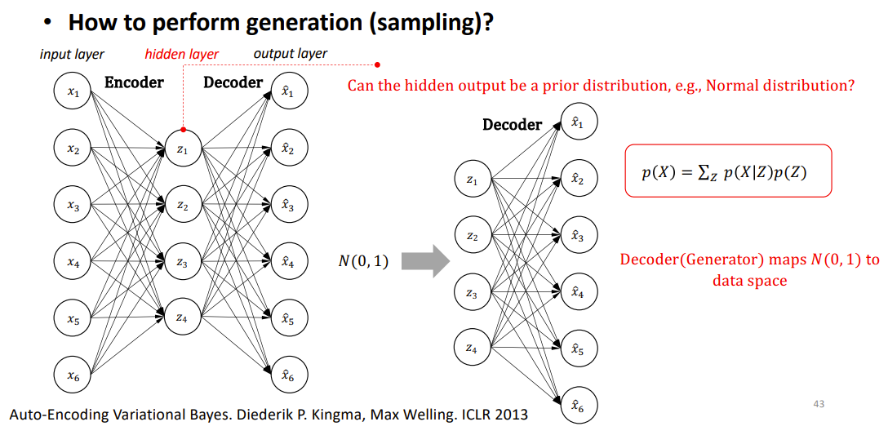
Variational Autoencoder

Slide 20
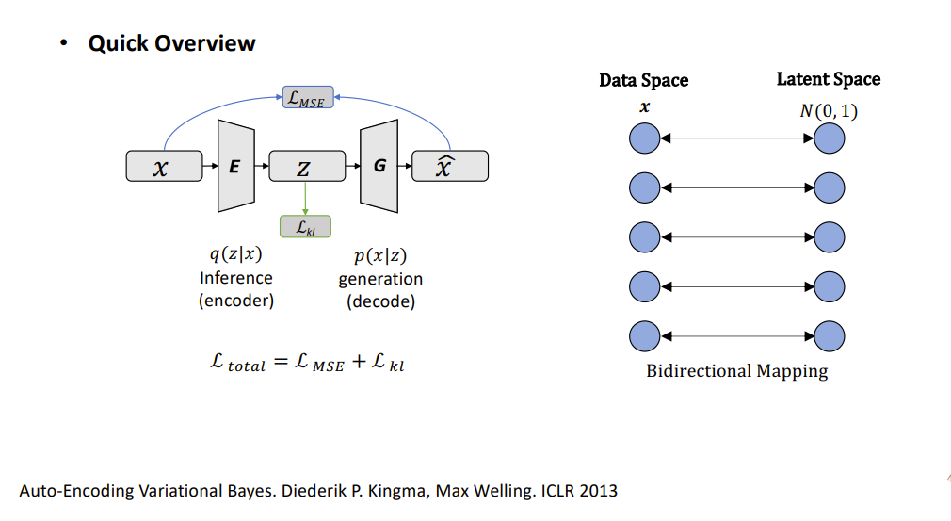
Variational Autoencoder

Slide 21
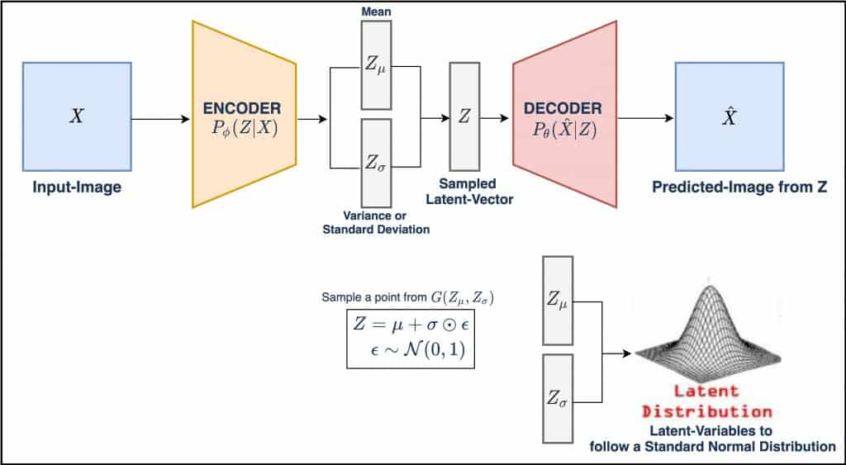
Variational Autoencoder

Slide 22
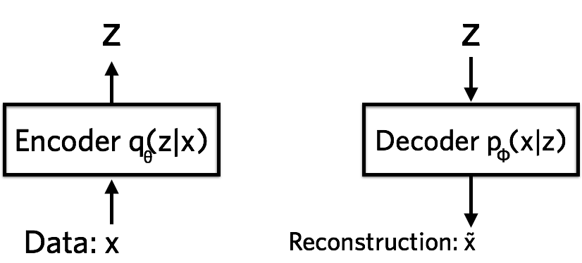
Variational Autoencoder
Encoder, Decoder
Auto-Encoding Variational Bayes. Diederik P. Kingma, Max Welling. ICLR 2013

Slide 23
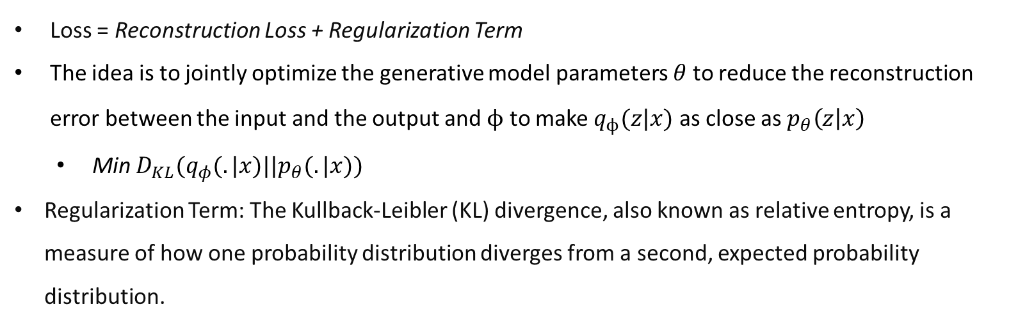
Variational Autoencoder
Loss function
Can be represented by MSE
regularization
Loss = Reconstruction Loss + Regularization Term
The idea is to jointly optimize the generative model parameters $θ$ to reduce the reconstruction error between the input and the output and $ϕ$ to make $q_{ϕ}(z|x)$ as close as $p_{θ}\left(z | x\right)$
Min $D_{KL}(q_{φ}(.|x)||p_{θ}(.|x))$
Regularization Term: The Kullback-Leibler (KL) divergence, also known as relative entropy, is a measure of how one probability distribution diverges from a second, expected probability distribution.
Auto-Encoding Variational Bayes. Diederik P. Kingma, Max Welling. ICLR 2013

Slide 24
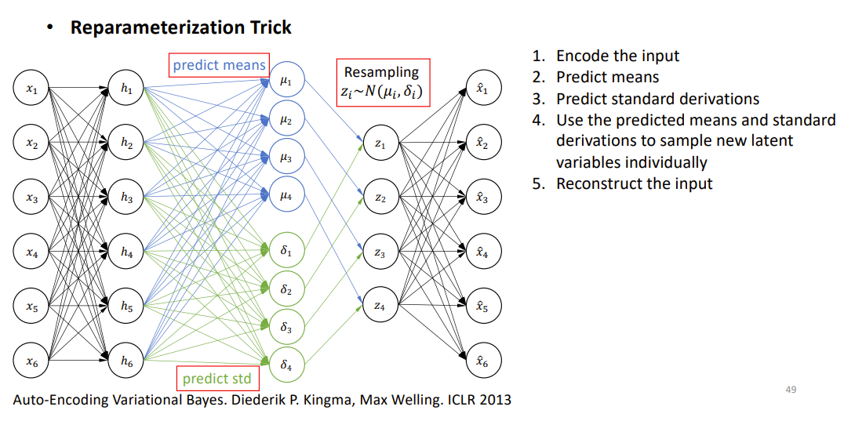
Variational Autoencoder

Slide 25
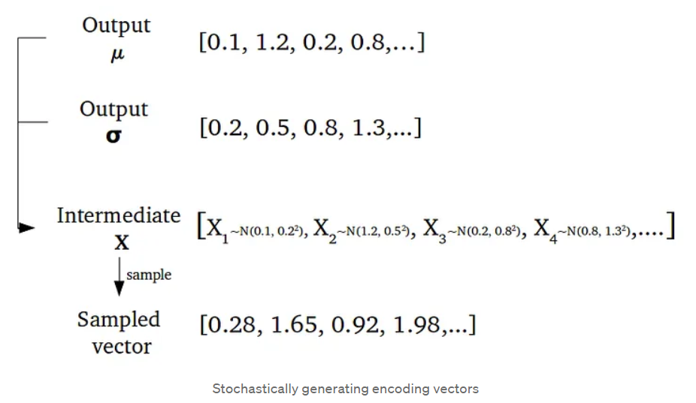
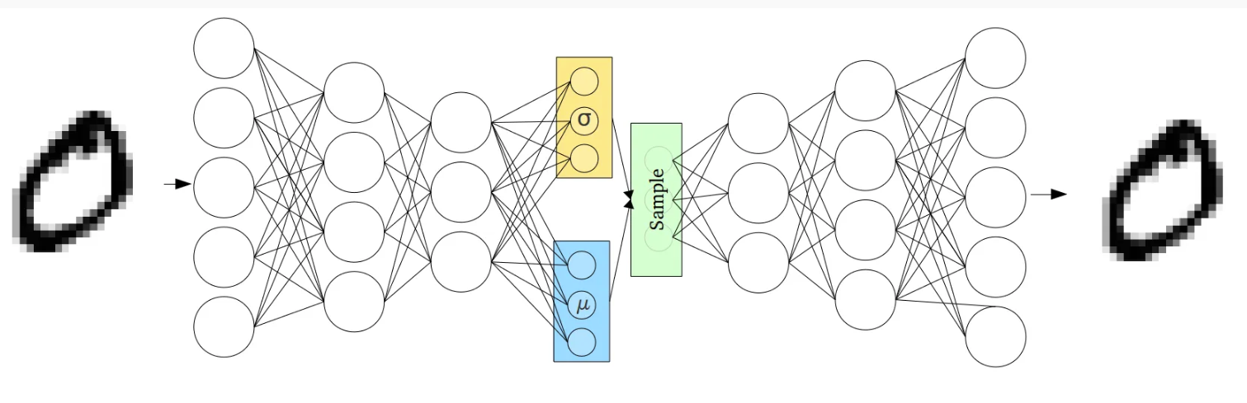
Variational Autoencoders (VAEs)
The latent spaces are, by design, continuous, allowing easy random sampling and interpolation.
The encoder’s outputs are two vectors of size n:
A vector of means, μ
A vector of standard deviations, σ.

Slide 26
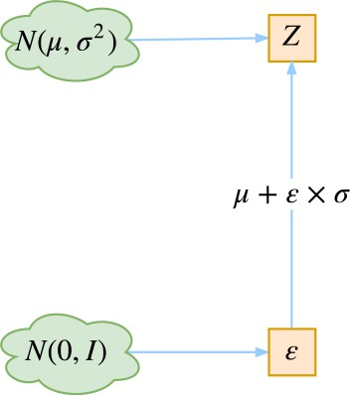
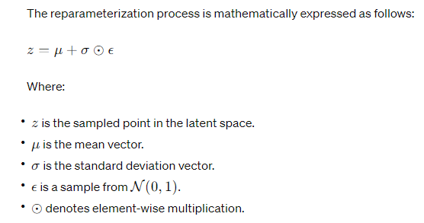

Variational Autoencoder
Reparameterization Trick
z ~ N(μ, σ) is not differentiable
To make sampling z differentiable
This trick allows the gradients to flow through the deterministic path (mean and standard deviation), making it possible to train the model using backpropagation.
Notes:
In a standard autoencoder, the encoder typically outputs the mean (�μ) and standard deviation (�σ) of the distribution in the latent space. To sample from this distribution, you would directly sample from �(�,�2)N(μ,σ2).
However, sampling directly from a stochastic node like this makes it difficult to compute gradients during backpropagation, which is essential for training the model. The reparameterization trick addresses this issue by introducing a deterministic transformation that separates the stochasticity from the parameters.
Instead of sampling directly from �(�,�2)N(μ,σ2), the reparameterization trick samples from a simple distribution, usually �(0,1)N(0,1), and then transforms the sampled values to obtain a sample from the desired distribution. This transformation is done using the mean and standard deviation obtained from the encoder.

Slide 27
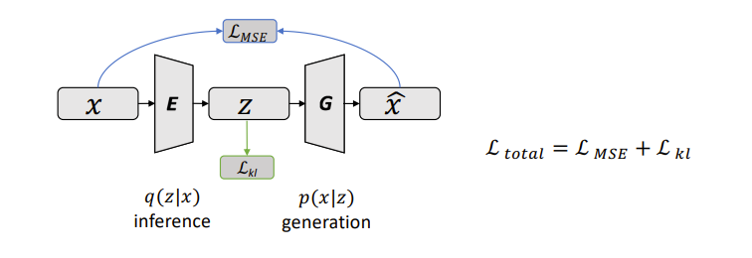
Variational Autoencoder
How can we know how well our variational posterior q(z∣x) approximates the true posterior p(z∣x)?
We can use the Kullback-Leibler divergence, which measures the information lost when using q to approximate p :
Notes:
In VAE, we optimize two loss functions: reconstruction loss and KL-divergence loss. We will learn about them in detail in the next section. For now, remember that the reconstruction loss ensures that the images generated by the decoder are similar to the input or the ones in the dataset. While the KL-divergence measures the divergence between a pair of probability distributions, in this case, the pair of distributions being the latent vector ( sampled from and ) and unit normal distribution . KL-divergence ensures that the latent-variables are close to the standard normal distribution.

Slide 28
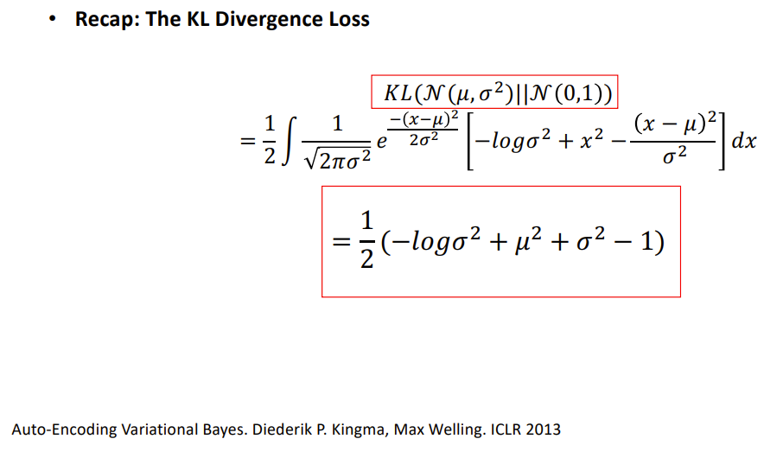
Kullback-Leibler divergence

Slide 29
Variational Autoencoder
VAE vs. Autoencoder
VAE : distribution representation, p(z|x) is a distribution
AE: feature representation, h = E(x) is deterministic
Auto-Encoding Variational Bayes. Diederik P. Kingma, Max Welling. ICLR 2013

